Slide 1
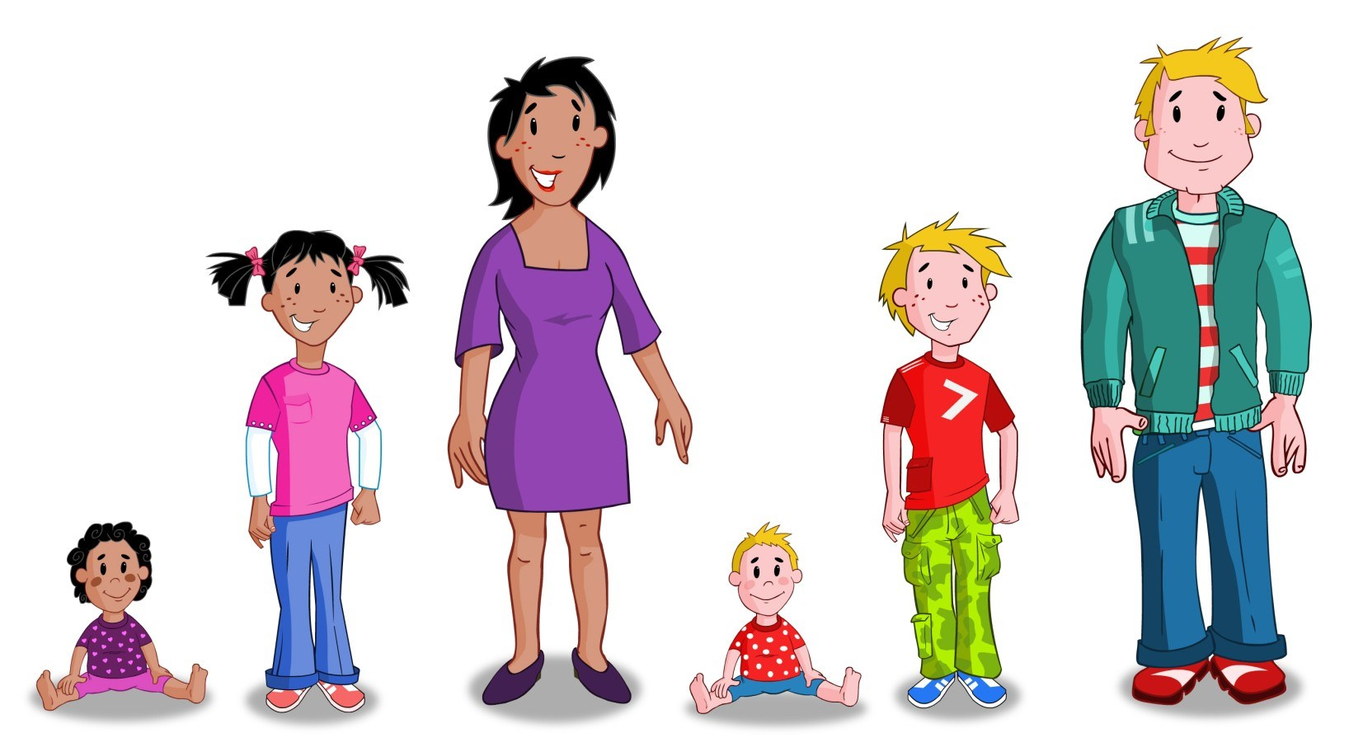

Relationships and Sexuality Education (RSE)
Information leaflet for parents and carers

Slide 2

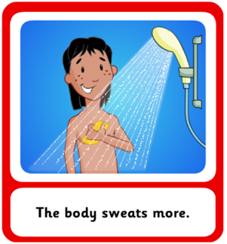
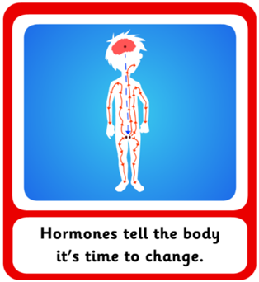
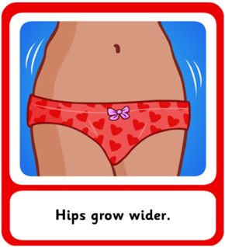

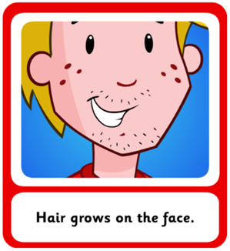
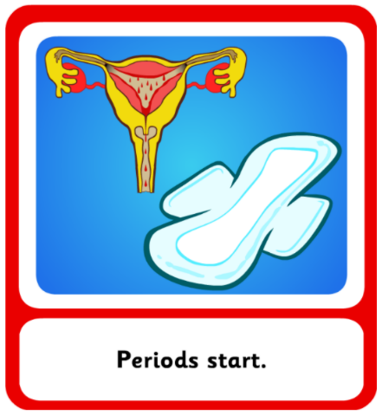
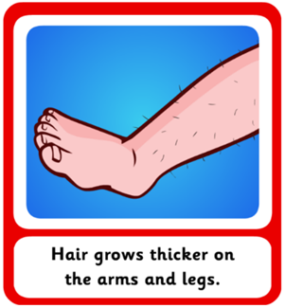
The purpose of this leaflet is to provide you with information on how and what and will be taught to the children in Key Stage 2.
RSE will be taught through:
The Curriculum for Wales Areas of Learning and Experience, e.g., Health and Wellbeing, Humanities, Science and Technology, Languages, Literacy and Communication
Cross-cutting themes, e.g., Goals and Aspirations, Citizenship
Circle time activities
Storybooks
Welsh Government and Public Health Wales approved resources, e.g., Tyfu i Fyny / Growing Up, Making Sense of Growing Up and Keeping Safe
Informal opportunities that arise in the classroom

Slide 3
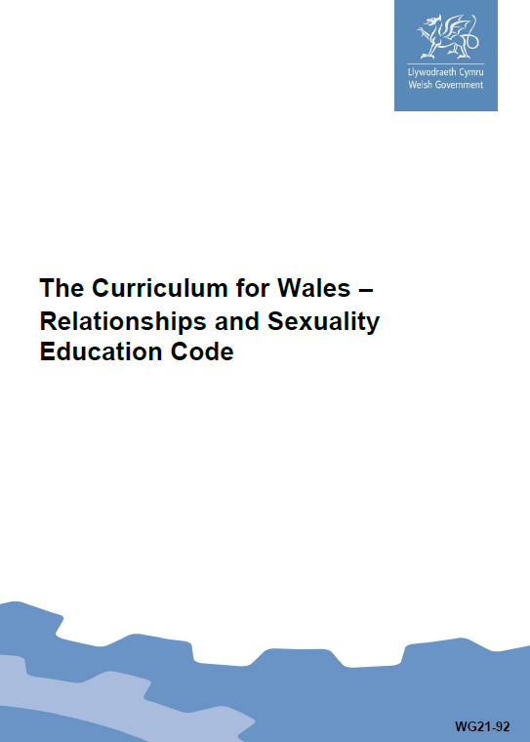

In 2022, Welsh Government published The Curriculum for Wales – Relationships and Sexuality Code.
The Code contains the mandatory requirements for teaching RSE and contains 3 broad Strands:
Relationships and identity
Sexual health and well-being
Empowerment, safety and respect
Each strand of learning is divided into 3 broad developmental phases:
Phase 1 - From approximately age 3
Phase 2 - From approximately age 7
Phase 3 - From approximately age 11
Children will build upon previous learning, consolidating knowledge and skills and apply them in new, relevant context.
RSE will be mandatory for all learners
aged 3 – 16 from September 2022.
From September 2022, parents and carers will no longer be entitled to withdraw their child/young person from RSE.
curriculum-for-wales-relationships-sexuality-education-code.pdf (gov.wales)

Slide 4
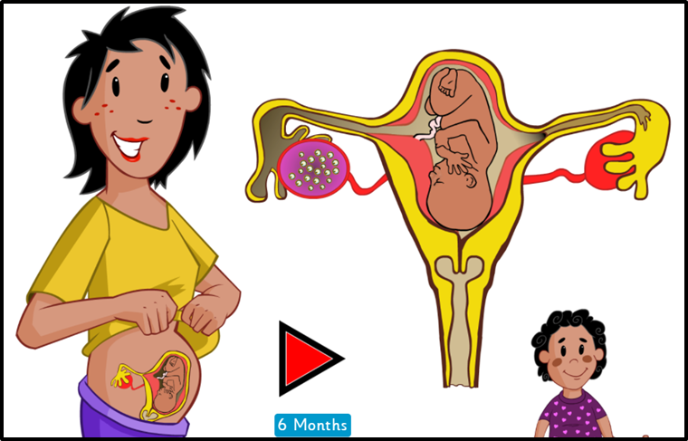
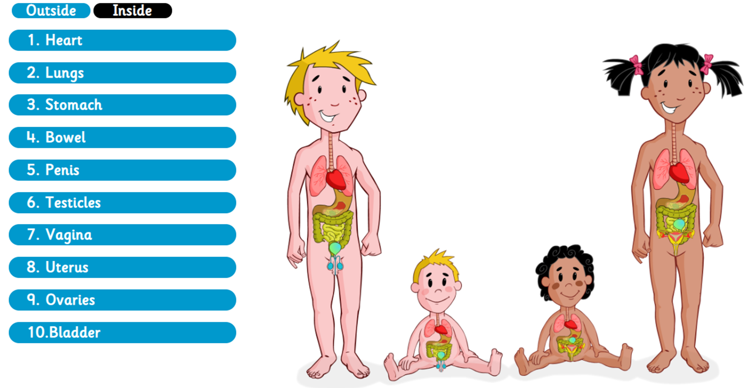
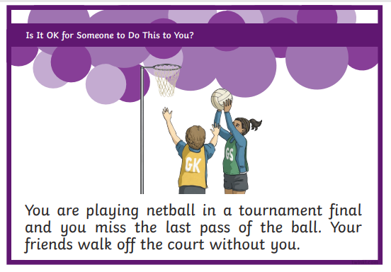
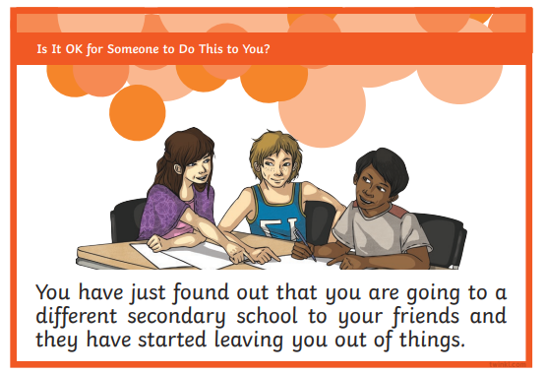
This is what your child will learn during Key Stage 2 (Phase 2).
Relationships and Identity
Children will:
be able to form and maintain relationships which are equitable, respectful and kind with a range of others;
understand and use effective communication, decision-making, managing conflict and refusal skills as part of ensuring their own and others rights and part of friendships and relationships;
recognise the characteristics of different families, friendship and peer relationships and the diversity of these;
understand positive behaviours in relationships and what can happen when relationships breakdown;
develop an awareness of how families, relationships and parenting are shaped by social and cultural norms and laws that have changed over time;
recognising how people’s relationships with others shape who they are and their happiness;
develop an awareness of how identity can be expressed in different ways;
value and recognise the contributions of everyone; and the importance of sex and gender equality;
recognise and know how to safely respond to and challenge gender and sexual stereotypes and unfair behaviour;
develop an awareness of how positive and negative social and cultural norms regarding sex, gender and sexuality influence relationships and behaviours
Sexual health and wellbeing
Children will:
develop their Knowledge and understanding of how reproductive organs develop in a human body. This includes understanding fertility and the processes of reproduction, including what supports menstrual health and well-being;
recognise the process of pregnancy and birth;
develop knowledge and understanding of how people experience significant physical, emotional, social and cognitive changes during puberty;
develop knowledge and skills needed to manage personal self-care and hygiene, including the importance of menstrual well-being;
develop an awareness that there are many different sources of information offline and online that help us learn about our bodies and affect how we feel about our body and other people’s bodies;
develop an awareness of how people can feel attracted to others as they mature and how this can lead to emotional and physical responses;
be able to identify trustworthy sources of information and able to raise issues and questions with trusted adults

Slide 5
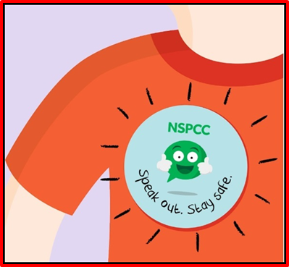
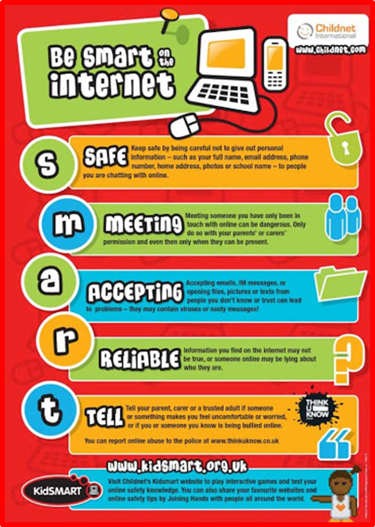

This is what your child will learn during Key Stage 2 (Phase 2).
Empowerment, safety and respect
Children will:
understand of the importance of fair treatment for all and of respect in all interpersonal interactions offline and online;
recognise the value of non-discriminatory behaviours and when and how to take safe action to respond to and challenge discriminatory behaviours;
understand the right for everyone to be free from harm or abuse;
develop an awareness of different kinds of harmful or abusive behaviour including physical, sexual, and emotional abuse and neglect, including peer on peer harassment and bullying and the role technology can play;
know how to seek support for oneself, and offer support to others;
know how to be a good friend and advocate for others;
understand of the right to bodily privacy, personal boundaries including online;
understand how behaviours may be perceived by others offline and online;
recognise which steps to take to keep safe from harm both in offline and online friendships;
understand the social and emotional norms and pressures that lead to non-consensual behaviours, friendships and relationships, for example, gender norms;
develop the skills to build consensual behaviours and relationships and know how to safely respond, challenge and report non-consensual behaviours and relationships offline and online;
Know how and when digital media can be shared safely, with permission and when it can be a source of harm;
Develop an awareness of the benefits and dangers of the internet and social media in forming friendships online;
explore the motives behind fabricated and digitally-altered media;
develop an understanding of the need to keep safe online, an ability to take steps to protect themselves and an ability to share with trusted adults where something is seen that shouldn’t have been, or is upsetting or uncomfortable;
develop an awareness of laws in place to protect from different forms of discrimination, violence, abuse, neglect and harassment
If you wish to see a copy of the school’s policy, resources or for more information please contact the school.

