Slide 1
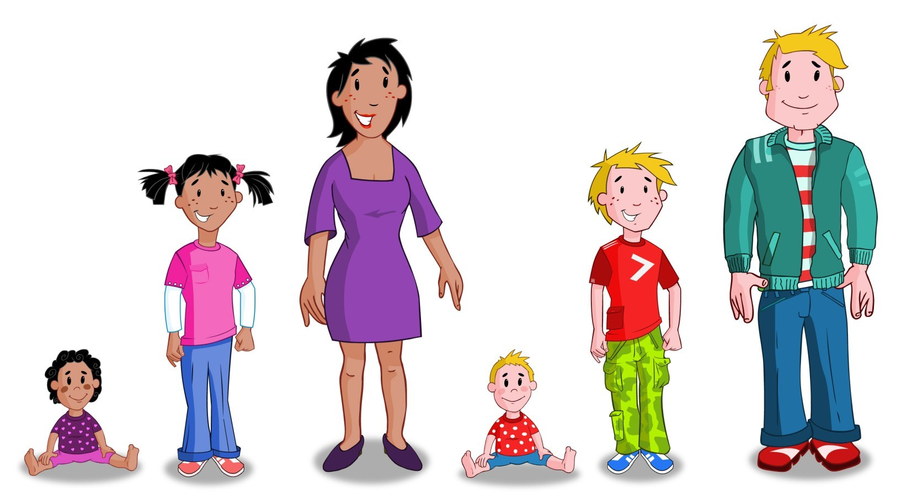

Relationships and Sexuality Education (RSE)
Information leaflet for parents and carers

Slide 2

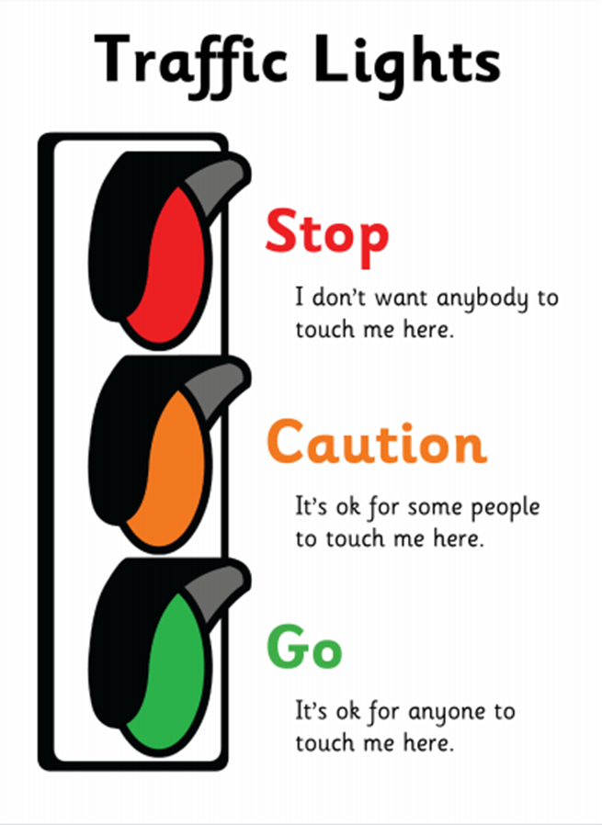
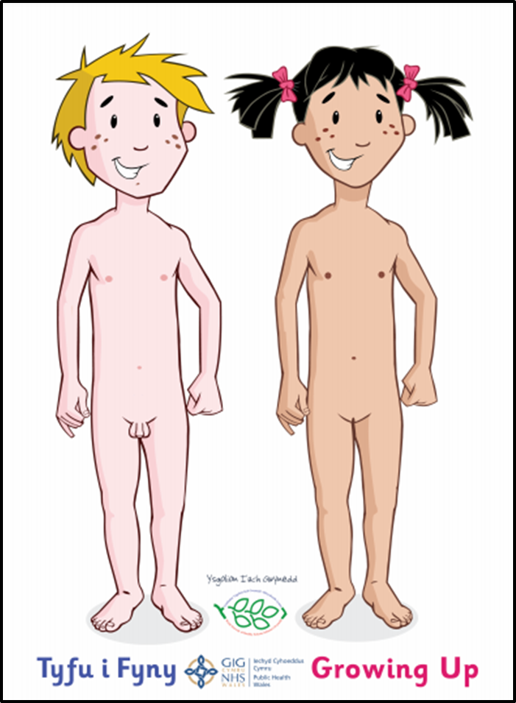

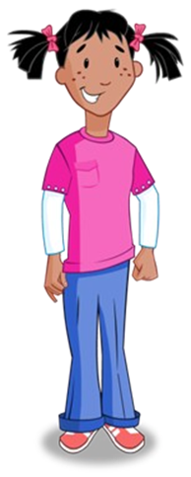
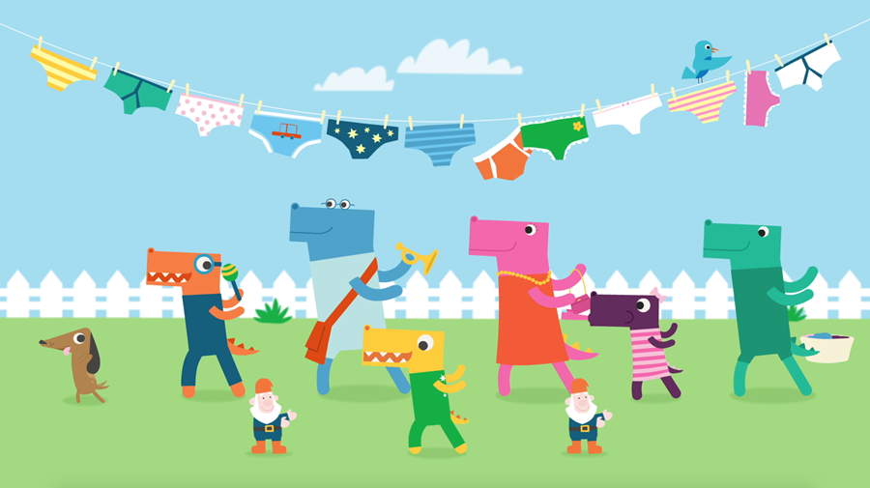





The purpose of this leaflet is to provide you with information on how and what and will be taught to the children in the Foundation Phase.
RSE will be taught through:
The Curriculum for Wales Areas of Learning and Experience, e.g., Health and Wellbeing, Humanities, Science and Technology, Languages, Literacy and Communication
Cross-cutting themes, e.g., Growing and Learning Together, People Who Help Us
Circle time activities
Storybooks
Welsh Government and Public Health Wales approved resources, e.g., Tyfu i Fyny / Growing Up, Making Sense of Growing Up and Keeping Safe
Informal opportunities that arise in the classroom

Slide 3
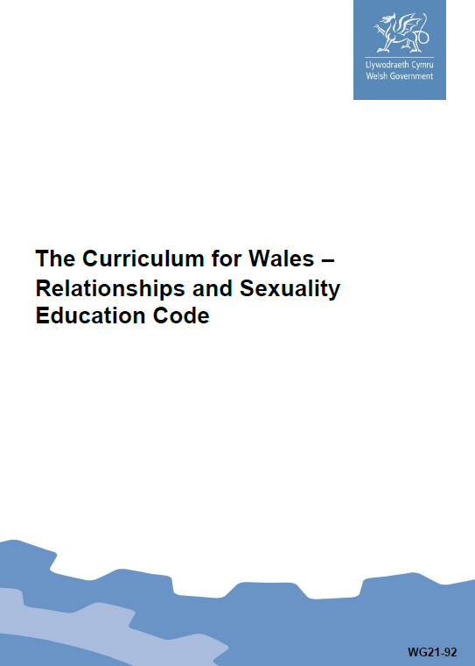

In 2022, Welsh Government published The Curriculum for Wales – Relationships and Sexuality Code.
The Code contains the mandatory requirements for teaching RSE and contains 3 broad Strands:
Relationships and identity
Sexual health and well-being
Empowerment, safety and respect
Each strand of learning is divided into 3 broad developmental phases:
Phase 1 - From approximately age 3
Phase 2 - From approximately age 7
Phase 3 - From approximately age 11
Children will build upon previous learning, consolidating knowledge and skills and apply them in new, relevant context.
RSE will be mandatory for all learners
aged 3 – 16 from September 2022.
From September 2022, parents and carers will no longer be entitled to withdraw their child/young person from RSE.
curriculum-for-wales-relationships-sexuality-education-code.pdf (gov.wales)

Slide 4
This is what your child will learn during the Foundation Phase (Phase 1).
Relationships and identity
Children will:
act with kindness, empathy and compassion in interactions with others immediate to them including family, friendship and peer relationships;
develop an awareness of how to communicate wants and needs in relationships, and begin to respect those of others;
develop an awareness of how needs relate to rights;
develop an awareness of the diversity of families and relationships, including friendship and peer relationships, and why these are important;
develop a sense of themselves, in the context of families, friends and communities;
recognise how people value different things and have different families, friends and communities;
experience inclusive behaviours, language and role modelling that show respect for others, whatever their gender;
recognise learners’ rights to be treated fairly, kindly and with respect.
Empowerment, safety and respect
Children will:
recognise harmful behaviour including behaviours which are discriminatory and the right to be free from discrimination;
be able to interact with others in a way that is fair;
recognise the right to be free from harmful, abusive and bullying behaviour;
develop an awareness of how to recognise positive and harmful behaviours, including bullying;
be able to share with a trusted adult when faced with harmful behaviours;
beginning to recognise that other people have thoughts, feelings and opinions that are different;
develop an awareness of the need to seek agreement in order to share, for example toys;
develop an awareness of everyone’s right to privacy, personal boundaries and which parts of the body are private;
be able to communicate if someone is touching them in a way that makes them feel uncomfortable;
develop an awareness of how to keep safe when using digital media, including sharing with a trusted adult when they feel uncomfortable or scared;
develop an awareness that everyone has the right to be safe and no one is allowed to harm anyone else;
be able to speak up for each other.
Sexual health and wellbeing
Children will:
use accurate terminology for all body parts, i.e. penis and testicles for males and breasts and vagina for females;
develop an awareness of the human life cycle and that reproduction is a part of life;
develop an awareness of how human bodies change as they grow;
develop an awareness of the importance of personal self-care and hygiene;
recognise that everyone’s body is unique and special to them;
develop an awareness of the different feelings one can have, recognising other people’s feelings and how these may differ to your own;
recognise trusted adults who can help them and whom they can talk to and ask questions of, especially when they feel unhappy or unsafe.
If you wish to see a copy of the school’s policy, resources or for more information please contact the school.

